Slide 1
Clipping with OGR in Python
30.06.2016
Freiburg, GIS+
Ruben Beck, Marcel Gangwisch

Slide 2
Outline
Introduction
Clipping: Live!
Code
Results

Slide 3
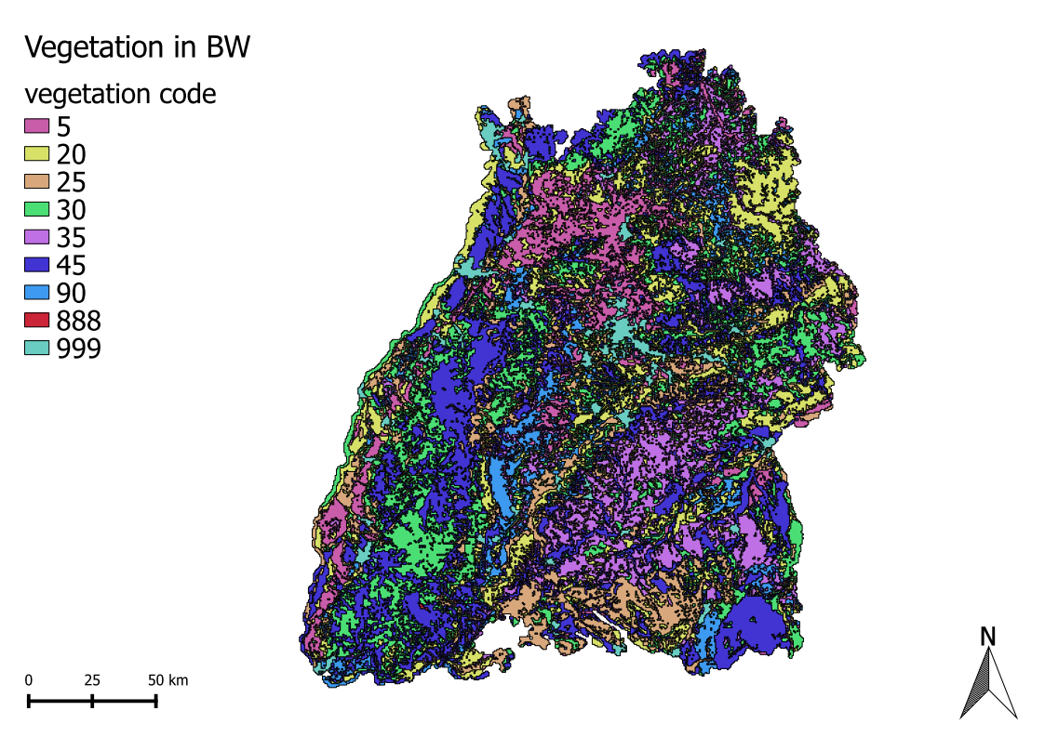

Slide 4
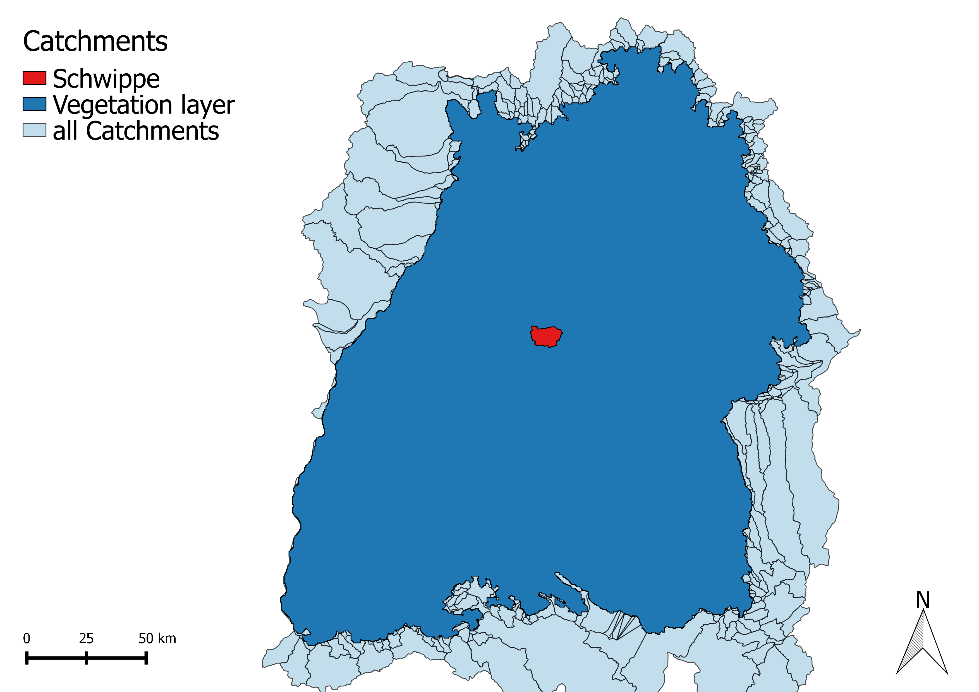

Slide 5
Let‘s show what we have done!

Slide 6
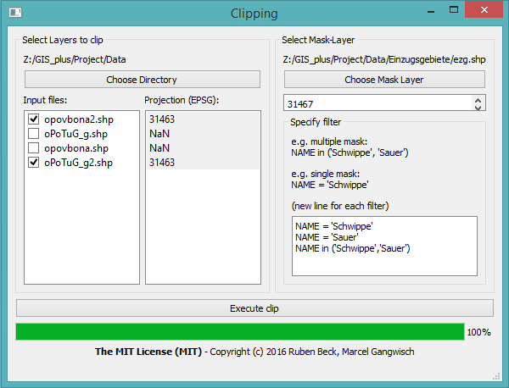
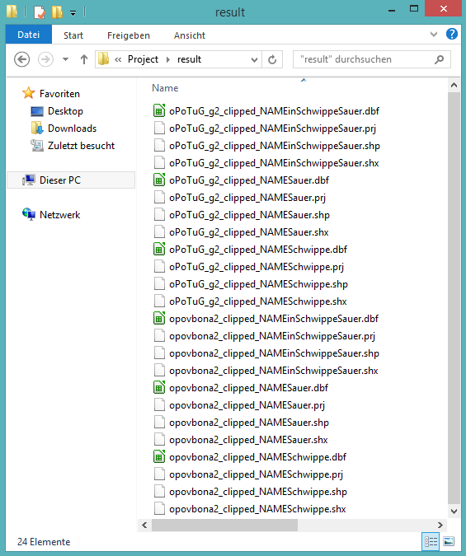
Results
Main window
Results

Slide 7
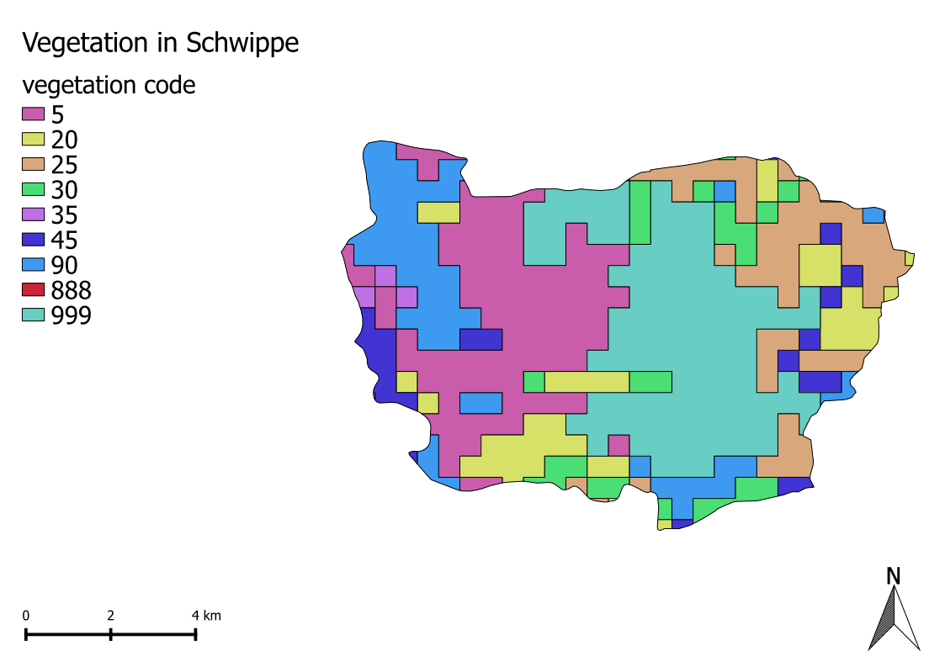
Results

Slide 8
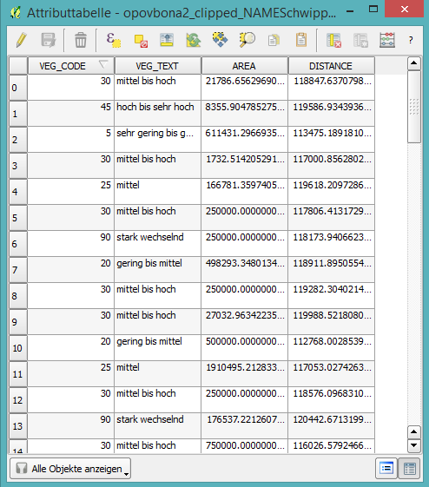
Results

Slide 9




Thank you for your attention
To check out the code visit: https://github.com/gummibumm/gis_clip
Special thanks to the open source projects:

